Slide 1
MongoDB Indexes 161094 – Divansh Anupam

Slide 2
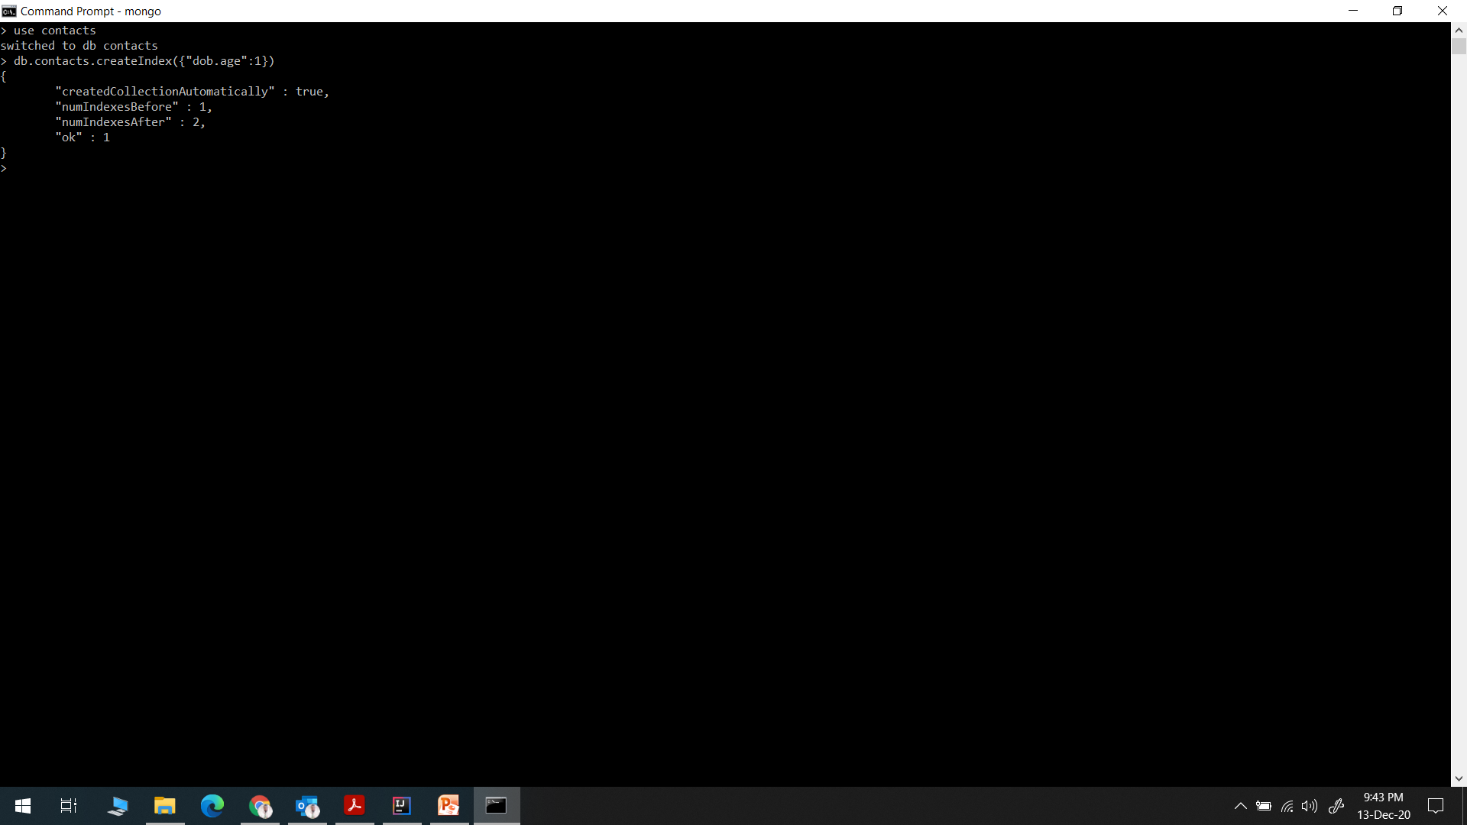
Create Index

Slide 3
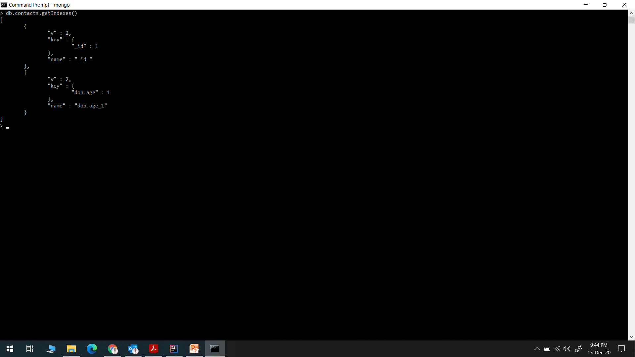
Get Index

Slide 4
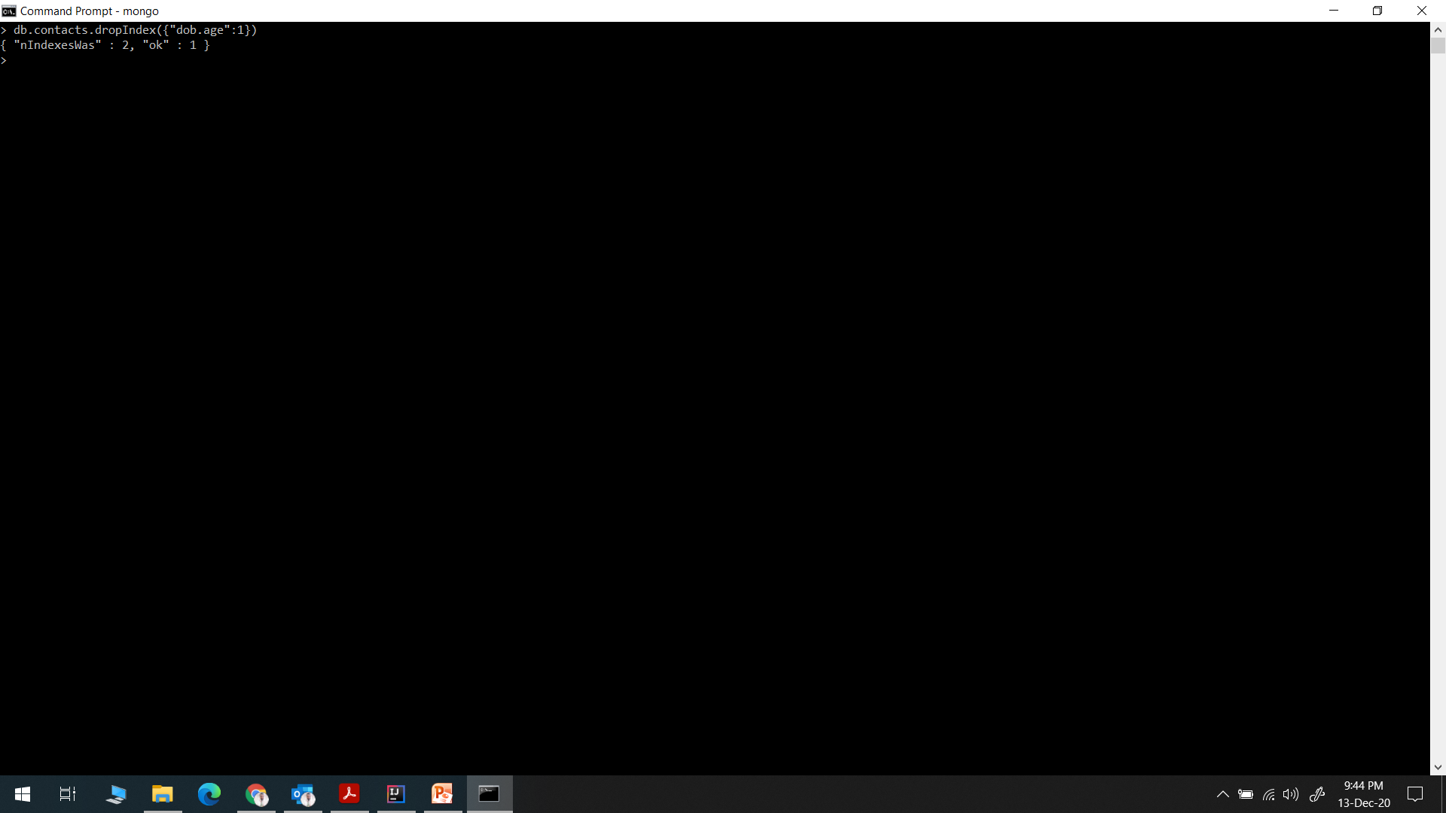
Drop Index

Slide 5
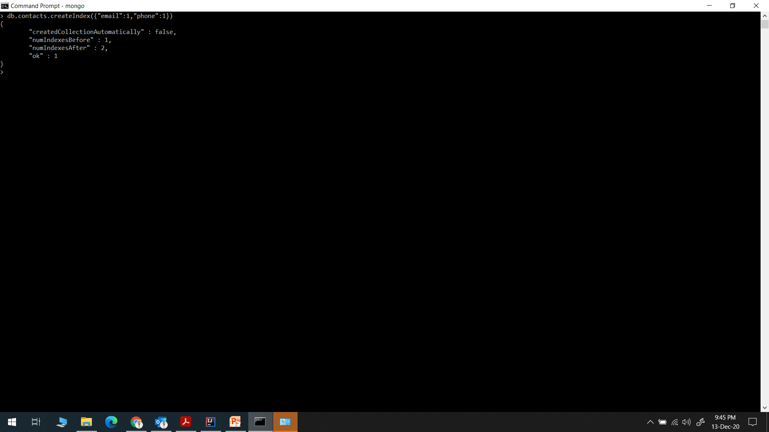
Single Index

Slide 6
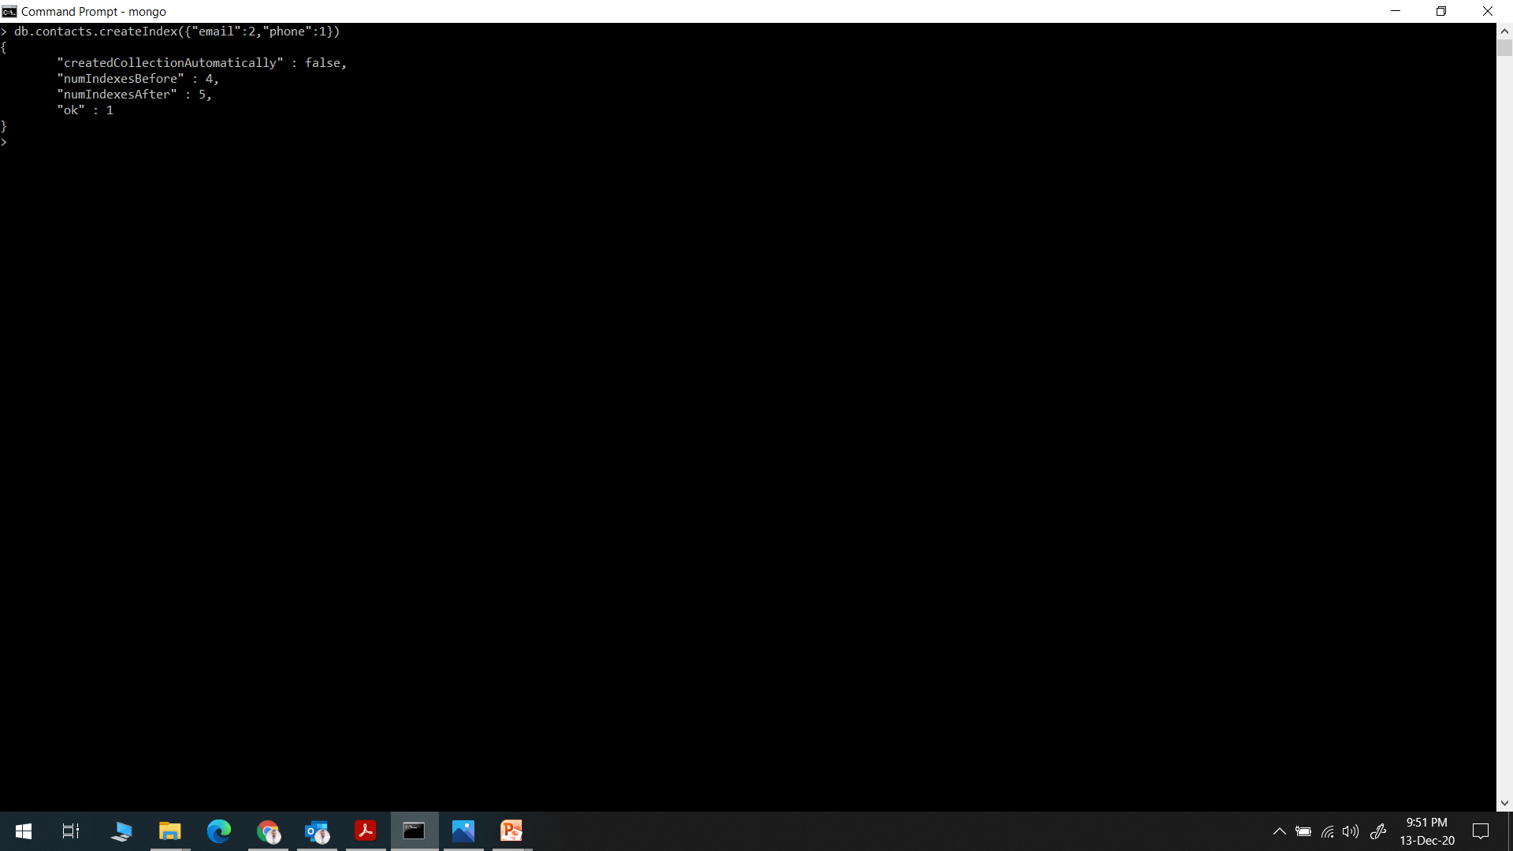
Compound Index

Slide 7
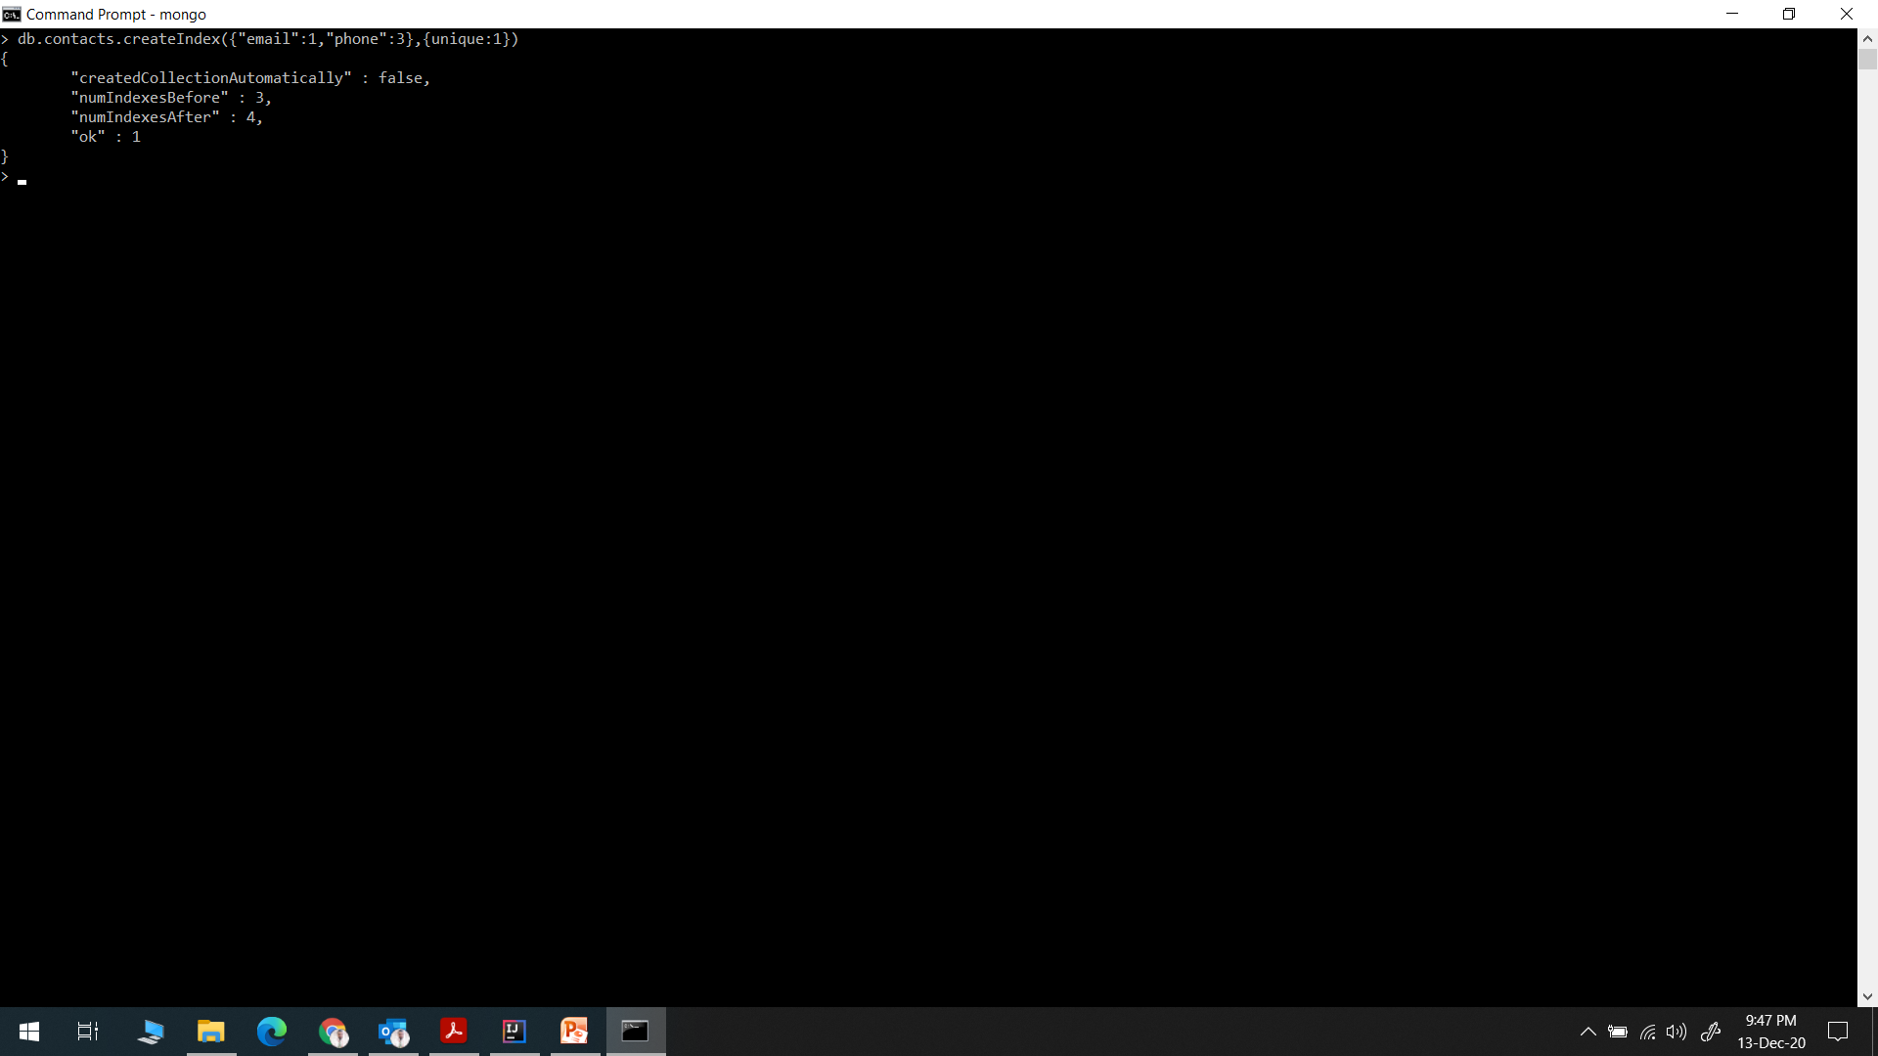
Unique Index

